Slide 1




My Algebra Interactive Notebook
$$3ab$$
$$2x+3y$$
$$\frac{5xy}{6}$$
Name :
Class :
Term 2 Semester 1
$$y=2x+1$$

Slide 2
Quickwrite
For 2 minutes, write everything you know about fractions, decimals and percentages.
Give examples of when fractions, decimals and percentages are used in real life.
Notes:
After 2 minutes is up, have students call out what they know, popcorn-style and write on the board.

Slide 3
Intro to Decimals video
https://youtu.be/w0or6RJrBWI
or
https://www.youtube.com/watch?v=gsvrhKka1nc

Slide 4
24
7
30
Date
Introduction to decimals
EQ – What are decimals and why do we use them?
Why Decimals?
Whole numbers are good for certain things, like counting the
number of students in this classroom. But for some things, we need to be more exact, and include parts of whole numbers.
Ex - You work in a medical lab and you need to tell your co-worker how much medicine you need.
“I need 1.25 grams of insulin.”
Decimals are good because:
They are easy to read! It is much easier to see that 0.75 is bigger than 0.65 rather than ¾ is bigger than 13/20.
They are easy to use. It is easier to use decimals over fractions when using calculators or computers

Slide 5
24
7
30
Date
Introduction to decimals
EQ – What are decimals and why do we use them?
What are decimals?
Decimals are numbers that are less than 1 but greater than 0
0 < 0.1 < 1 (0.1 is between 0 and 1, so it is a decimal)
They appear to the right of the decimal point
whole number decimal
39.1
“39” is the whole number part
“.1” is the decimal part
“39.1” is read…
“Thirty-nine and one tenth”
“0.1” is the same thing as “.1”. “.1” is just a lazy way of writing the number.
“0.1” is the same thing as “.1”. “.1” is just a lazy way of writing the number.

Slide 6
24
7
30
Date
Introduction to decimals
EQ – What are decimals and why do we use them?
Take the following example:
ten-thousands
ten-thousandths
thousandths
thousands
hundredths
hundreds
tenths
tens
ones
10,000.
+ 2,000.
+ 300.
+ 40.
+ 5.
+ .6
+ .07
+ .008
+ .0009
12,345.6789
1 2 3 4 5 6 7 8 9
The “3” is in the hundreds column, so there are “3 hundreds”.
The “7” is in the hundredths column, so there are “7 hundredths.”
Remember, decimals have a “th” at the end of their names.

Slide 7
Try it yourself
What numbers are these?
Three and two hundredths = 3.02
Forty and two thousandth =
Twelve and twelve hundredths =
Eighty and eight ten-thousandths =
How do you say these numbers?
37.03 = Thirty-seven and three hundredths
9.004 =
20.0004 =
100.1 =
Arrange the following sets of decimals in descending order:
A) 3.625, 3.256, 2.653, 3.229, 2.814, 3.6521
B) 11.907, 11.891, 11.898, 11.875, 11.908, 11.799
C) 0.043, 1.305, 0.802, 0.765, 0.039, 1.326

Slide 8
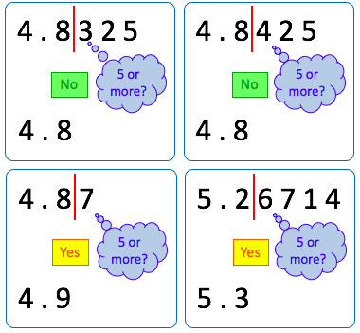
24
7
30
Date
Introduction to Decimals
EQ – What are decimals and why do we use them?
Rounding to one
decimal place
Summary:

Slide 9
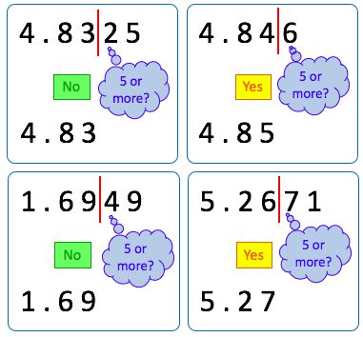
24
7
30
Date
Introduction to Decimals
EQ – What are decimals and why do we use them?
Rounding to two
decimal places
Summary:

Slide 10
Your Turn
Copy &
complete
this table:
Number | To 1DP | To 2DP | To 3DP
63.4721
87.6564
149.9875
3.54029
0.59999

Slide 11
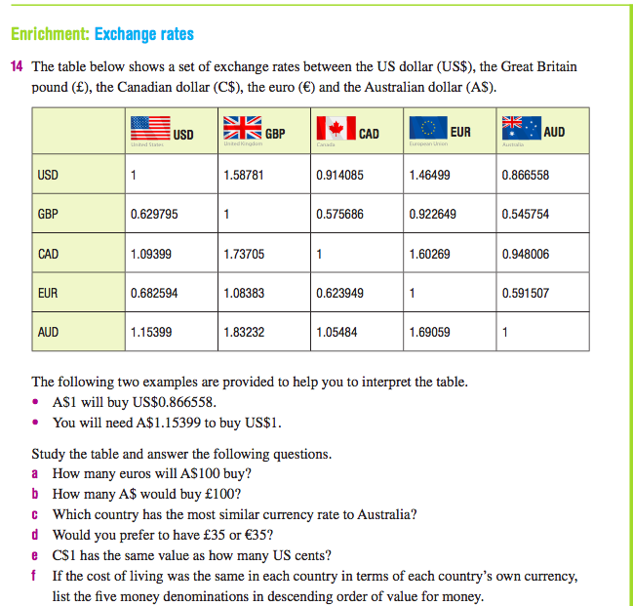
Extension Activity

Slide 12
Notes Review
24, 7 ,30
Date
Title
Essential question
Notes complete
Notes complete with colour and diagrams
Questions completed
Contents page filled in
Formula page filled in

Slide 13
Homework
Review your notes and write a summary answering the essential question.

